Slide 1
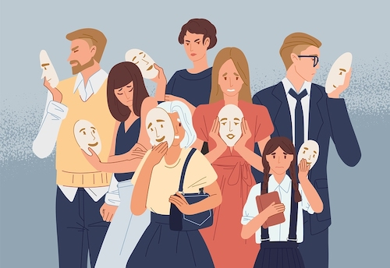
personality
Ms. Rabia Ijaz
Lecturer (Psychology)
Science and Humanities

Slide 2
Learning outcomes
Understand aspects of personality
Understanding personality through 5 factors model of personality
Personality in regards to ego defense mechanisms.
Learning about Real self and Ideal self

Slide 3

PERSONALITY
The word personality stems from the Latin word persona, which refers to a theatrical mask worn by performers in order to either project different roles or disguise their identities.
It is believed that personality remains fairly consistent throughout life.

Slide 4
Definition
Personality is the characteristic patterns of thoughts, feelings, and behaviors that make a person unique.

Slide 5
Individual differences in characteristic patterns of thinking, feeling, and behaving
1. “Thinking”: Personality includes differences between people in how they typically think. Example: Do people tend to focus on the positive (optimists) or the negative (pessimists)?
2. “Feeling”: Personality includes differences between people in how they typically feel. Examples: Do people tend to be happy or unhappy? Do they experience intense emotions or not? Do they get angry easily? Are they especially sensitive to rejection?
3. “Behaving”: Personality includes differences between people in how they typically behave. Examples: Do they tend to talk a lot? Do they usually go along with what other people want or insist on doing things their way? Are they neat and tidy or sloppy and disorderly? Do they like to try new things, or do they always order the same thing when they go out to eat?

Slide 6
Personality does not refer to physical characteristics, abilities, or temporary states.
1. Personality refers to differences between people in their psychological characteristics, not physical or biological differences (e.g., height or age). Example: A person’s level of testosterone can influence his or her typical pattern of behavior. However, level of testosterone itself isn’t considered a personality characteristic, though it may be related to personality characteristics.
2. Personality is about what people are typically like, not what they are capable of at their best. Example: Just because someone can be an excellent negotiator or a skilled chess player, that doesn’t mean it is part of his/ her personality.
3. Personality doesn’t include fleeting states like hunger, arousal, or mood. Just because a person happens to be happy at a given moment doesn’t mean it is part of his/her personality.

Slide 7
Personality origins
Debate whether personality is innate (nature) or learned from one’s experiences in childhood and beyond (nurture).
Both sides are partly correct.
Personality is influenced by genes and can be observed even in young infants, but it is also shaped by the experiences and changes over the course of a person’s life

Slide 8
Environmental influences on personality
Both genes and people’s experiences account for differences between people. Same environment influences people in different ways. Example: Having a strict parent might make some kids more rule-abiding and others more rebellious.
Few life experiences that have a systematic effect on personality (i.e., that tend to shift everyone’s personality in the same way). Examples: When young adults enter their first serious romantic relationship, they tend to become more agreeable and more emotionally stable. Also, when people start their first job, they tend to become more agreeable and more conscientious.

Slide 9
The born versus made/nature versus nurture debate
Personal
character traits
Culture
of society
INFLUENCES ON
INDIVIDUALS
antecedent
influences
Situational
factors
From: Burns, 2001

Slide 10

Theories of personalities
Psychoanalysis theory
Sigmund Freud
Humanistic theories
Carl Rogers
Abraham Maslow
Social-Learning Theories
Abraham Maslow
Carl Rogers
Trait theories

Slide 11
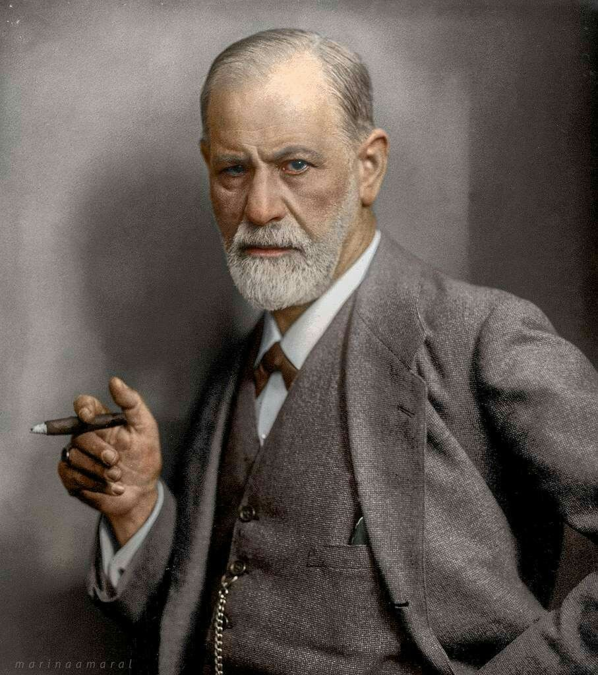
PSYCHOANALYSIS: Sigmund Freud
Turn your eyes inward, look into your own depths, learn to first know yourself.

Slide 12
PSYCHOANALYITC THEORIES OF PERSONALITY
Stems from Sigmund Freud’s theories about how and why people become who they are.
The importance of the unconscious: The psychoanalytic theories of personality emphasize that an individual’s behavior (and thus his or her personality) is not always the result of conscious mental processes; many of the processes underlying behavior are unconscious
Personality development according to the psychoanalytic perspective: Freud argued that early childhood experiences are extremely important for personality development. Adults are the way they are in large part because of what happened to them in childhood.

Slide 13
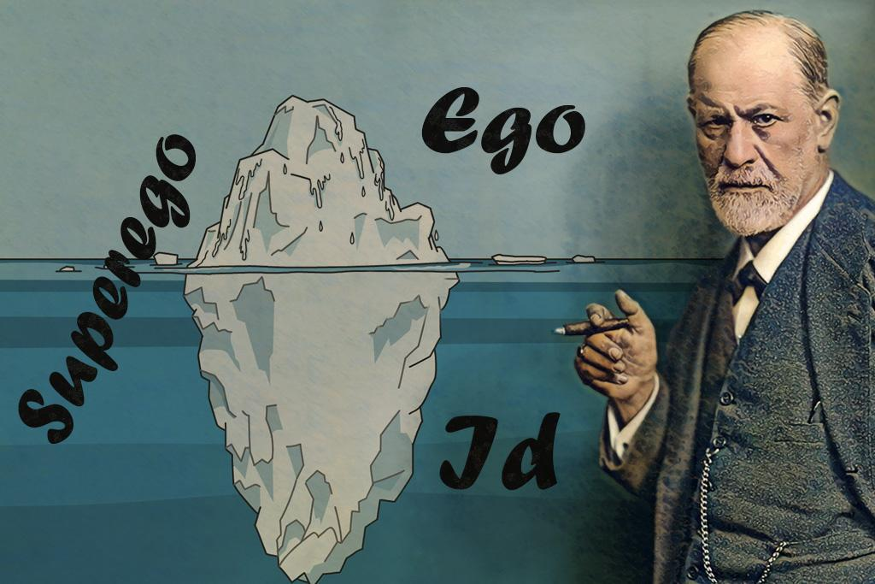
SIGMUND FREUD- Psychoanalysis
Sigmund Freud was an Austrian neurologist who became known as the founding father of psychoanalysis.
Proposed the first complete theory of personality.
Focused on childhood experiences.
Sigmund Freud’s psychoanalytic theory grew out of his therapeutic work with clients and emphasized the importance of the unconscious.

Slide 14
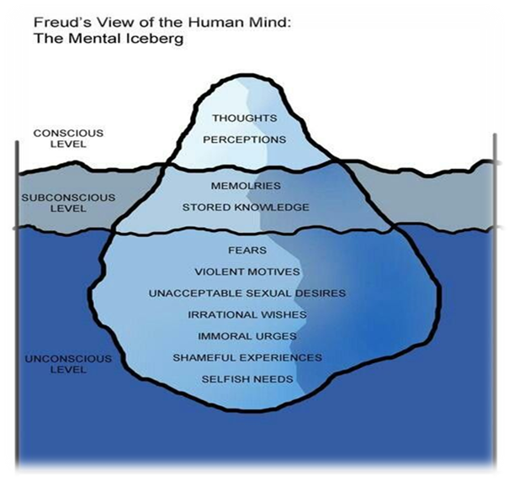
Freud described three levels of awareness.
Freud believed that most of the important personality processes occur below the level of conscious awareness.
Like an iceberg, the most important part of the mind is the part you cannot see.
Our feelings, motives and decisions are actually powerfully influenced by our past experiences, and stored in the unconscious.

Slide 15
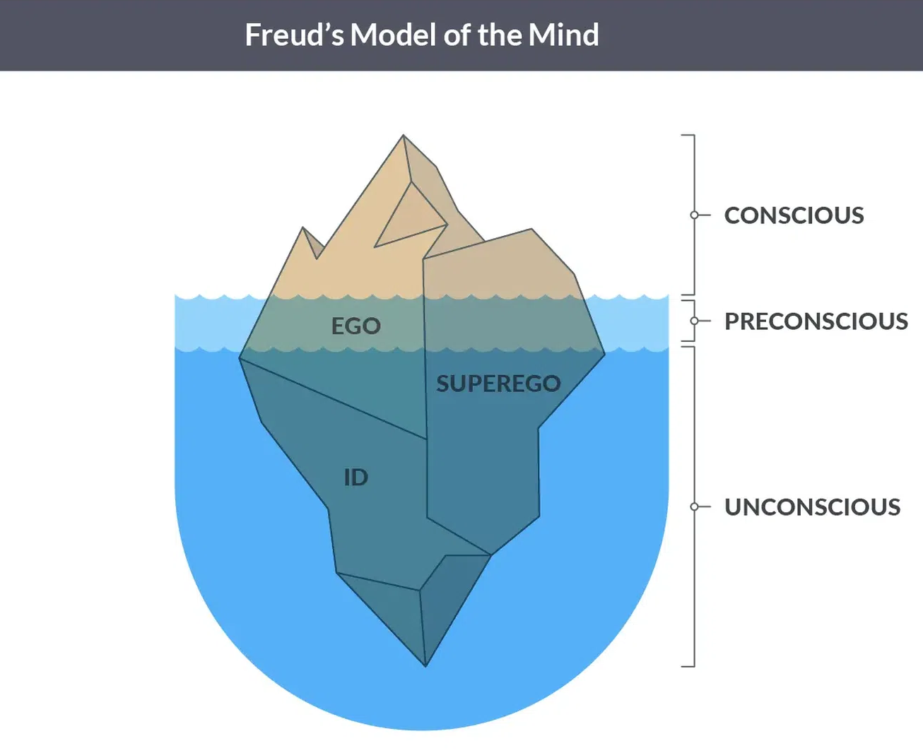
Freud divided personality into three structures: the id, the ego, and the superego
He believed that personality is constantly in conflict due to these structures.

Slide 16
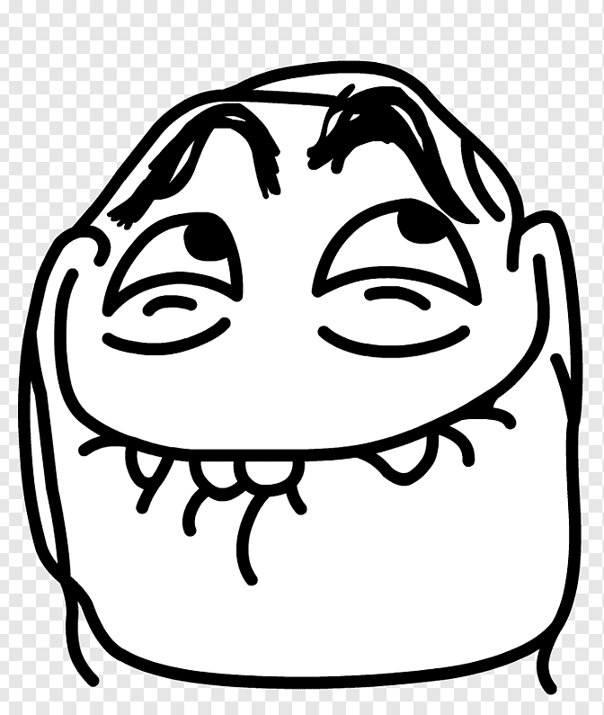
THE STRUCTURE OF PERSONALITY
The Id – Reservoir of Psychic Energy
Most primitive part of the mind; what we are born with.
Source of all drives and urges, The id seeks instant gratification for our wants and needs. (selfish in nature)
Operates according to the pleasure principle .
In other words, the id wants whatever feels good at the time, with no consideration for the reality of the situation.
Example: Hamnah was thirsty. Rather than waiting for the server to refill her glass of water, she reached across the table and drank from Saad's water glass, much to his surprise.

Slide 17
The Structure of Personality
The Ego- Executive of Personality
Within the next three years, as the child interacts more and more with the world, the second part of the personality begins to develop. Freud called this part the Ego
Works on reality principle .
Mediates between id, superego, and environment
Example: Hamnah was thirsty. However, she knew that her server would be back soon to refill her water glass, so she waited until then to get a drink, even though she really just wanted to drink from Saad's glass.

Slide 18

THE STRUCTURE OF PERSONALITY
The Superego- Upholder of Values and Ideals
Develops around age 5 develops due to the moral and ethical restraints placed on us by our caregivers.
Many equate the superego with the conscience as it dictates our belief of right and wrong.
Develops through interaction with people.
The part of the mind that internalizes the values, morals /ethics, and ideals of society
Example: Hamnah was thirsty, she’ll think drinking water from someone’s glass without permission is wrong.

Slide 19
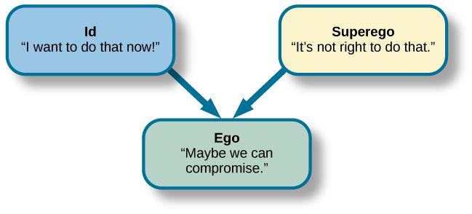
Even though the superego and the ego may reach the same decision about something, the superego's reason for that decision is based more on moral values, while the ego's decision is based more on what others will think or what the consequences of an action could be on the individual.

Slide 20
The Structure of Personality
In a healthy person, according to Freud, the ego is the strongest so that it can satisfy the needs of the id, not upset the superego, and still take into consideration the reality of every situation.
If the id gets too strong, impulses and self gratification take over the person's life. For example: In criminals they have selfishness
If the superego becomes to strong, the person would be driven by rigid morals, would be judgmental and unbending in his or her interactions with the world

Slide 21
Defense mechanisms
An unconscious psychological operation that functions to protect a person from anxiety-producing thoughts and feelings related to internal conflicts and outer stressors.
These are the ways of dealing with difficult feelings which your mind uses.

Slide 22
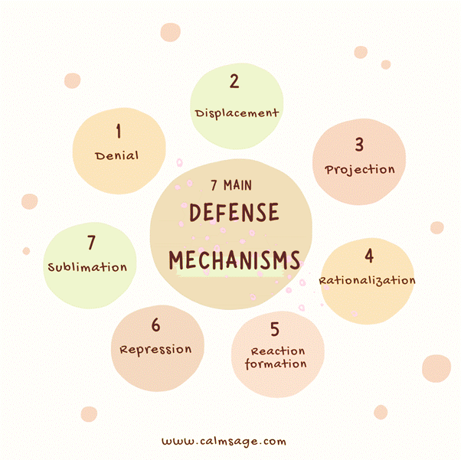

Slide 23
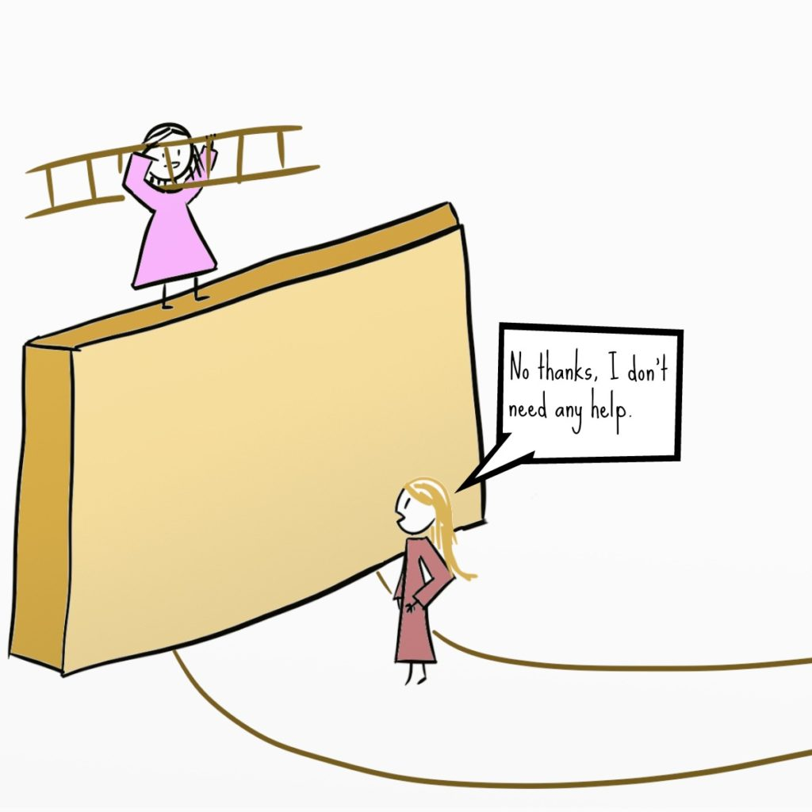
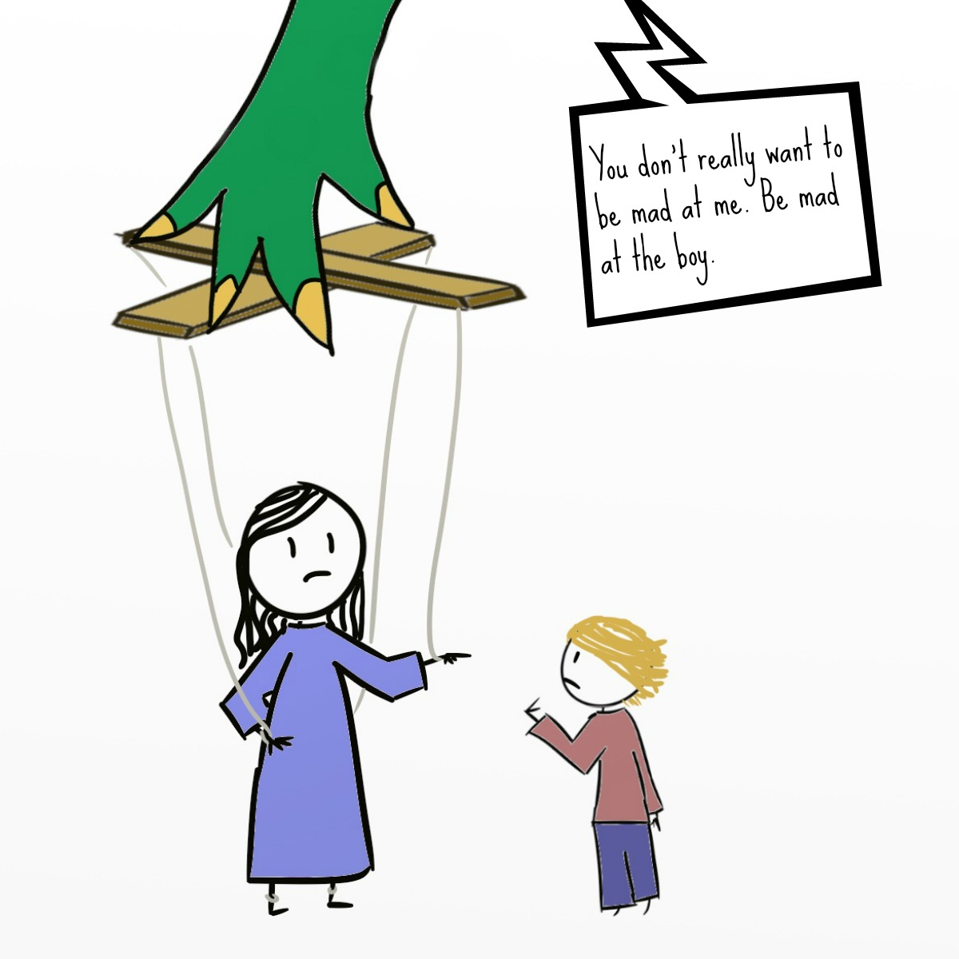
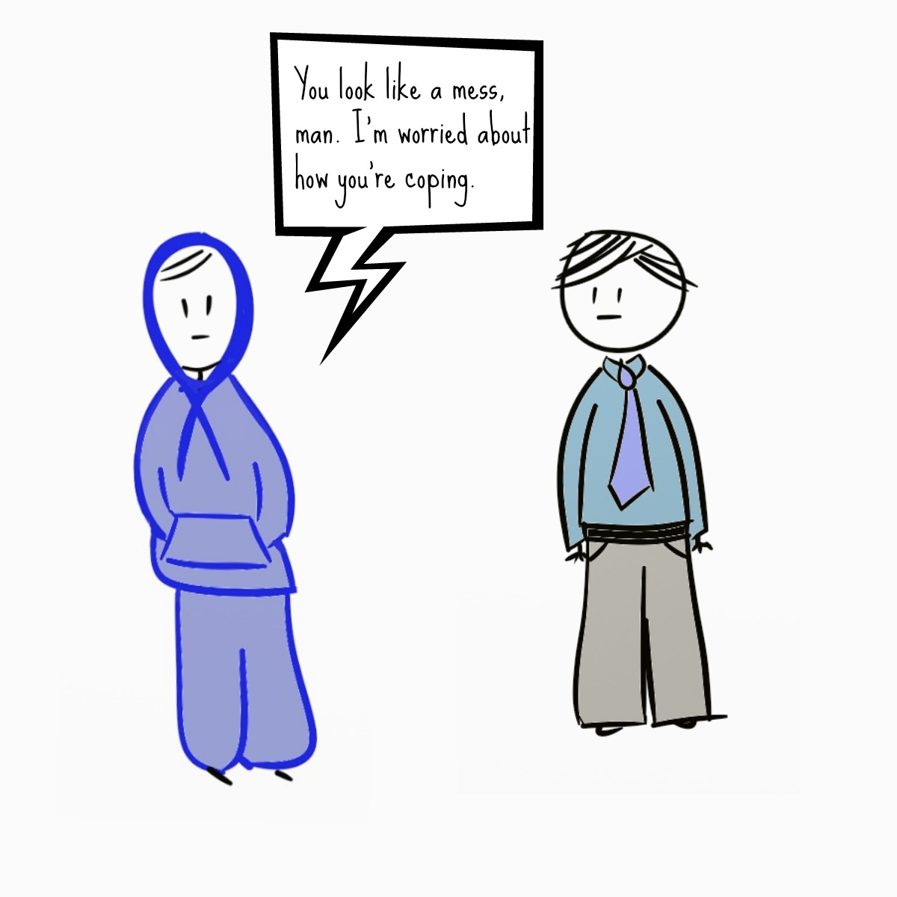
DENIAL
A refusal to accept reality.
denying that your physician's diagnosis of cancer is incorrect and seeking a second opinion
DISPLACEMENT
Taking out impulse/negative emotions on a less threatening target.
slamming a door instead of hitting as person, yelling at your spouse after an argument with your boss
PROJECTION
Placing one’s own unacceptable thoughts onto others, as if the thoughts belonged to them and not to oneself.
when losing an argument, you state "You're just Stupid"

Slide 24
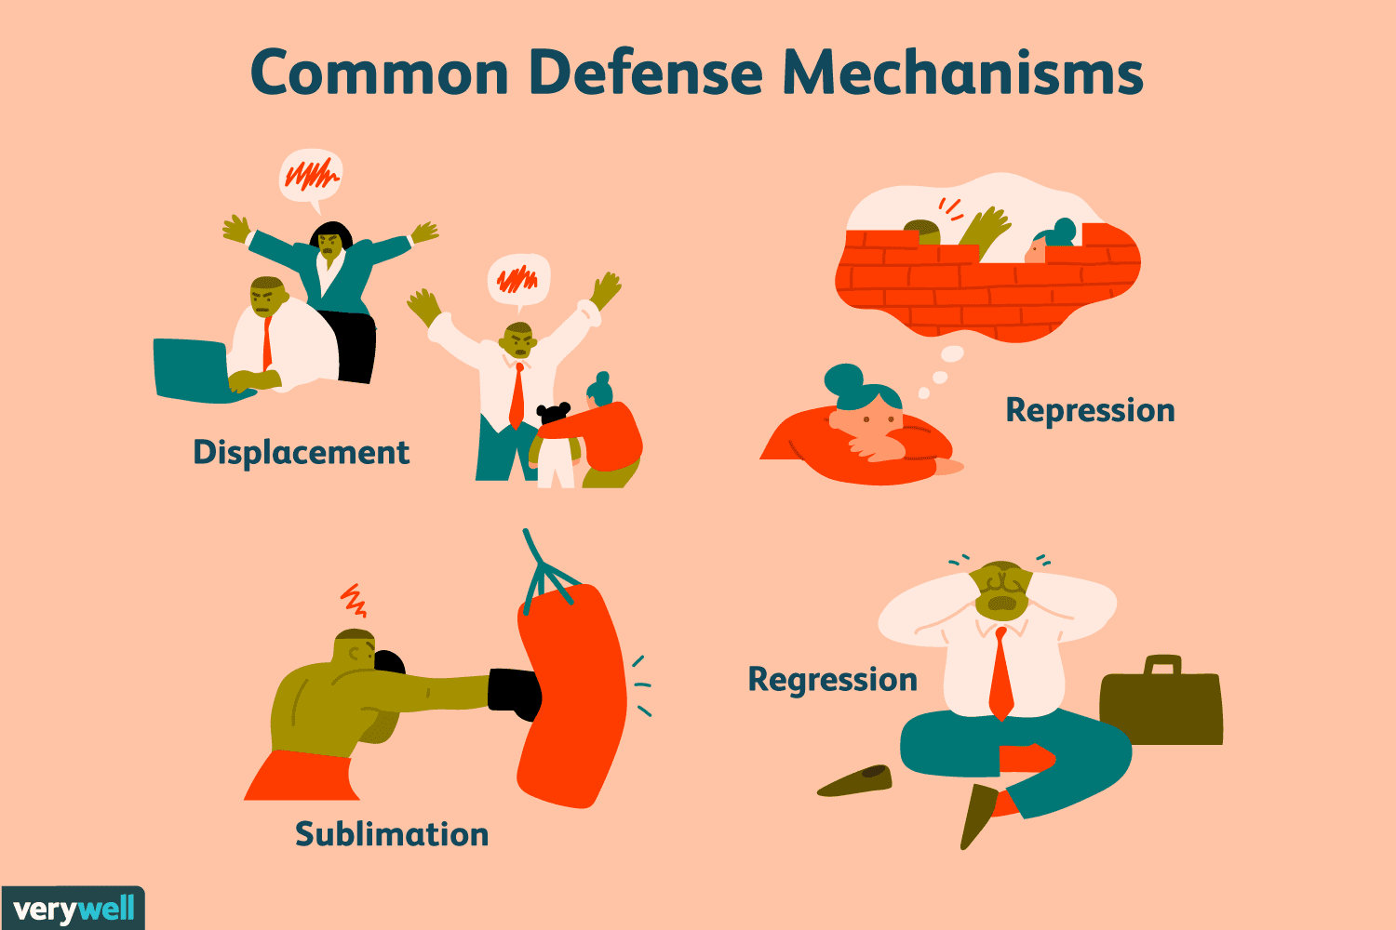
REGRESSION: returning to a previous stage of development/ using previous developmental behaviors when faced with overwhelming stress.
E.g.: sitting in a corner and crying after hearing bad news; throwing a temper tantrum when you don't get your way
E.g.: Reverting to sucking thumb when in stress
SUBLIMATION: Acting out unacceptable impulses in a socially acceptable way
E.g. A man who has aggressive nature decides to pursue a career as a boxer.
REPRESSION: “Pushing” threatening or conflicting events out of conscious memory
E.g.: A man is jealous of his good friend’s success but is unaware of his feeling of jealousy.
Elise, who failed her math exam in board, cannot remember the event at all.

Slide 25


RATIONALIZATION
Making up acceptable excuses for unacceptable behavior.
E.g.. Stating that you failed a test because the teacher doesn’t like you, when the real reason was you didn’t study.
HUMOR
Focusing on the humorous aspects of an uncomfortable or adverse situation.
E.g.. A nervous patients jokes about an upcoming operation.
SUPPRESSION
Voluntary exclusion from awareness, anxiety producing feelings, ideas and situation.
E.g.: A nursing student states, “”I cannot talk about my recent board, please change the topic.

Slide 26
SOCIAL-COGNITIVE THEORIES OF PERSONALITY
A. Behaviorism: The theory that people’s behavior is the result of the rewards and punishments they have experienced in the past.
The view that people are different from one another because they have experienced different patterns of rewards and punishments, which have reinforced different behaviors in different people; therefore, they have developed different personalities.
Example: A person whose parents laughed at her jokes all the time might end up making more jokes later in her life than someone whose parents did not react when she made jokes.

Slide 27
B. Social learning theory (Bandura): based on behaviorism but adds one crucial element: the view that what shapes behavior is not only the actual reinforcements (rewards and punishments) that people experience, but how the people interpret these reinforcements. Social learning theory also says people can learn from observing other people being rewarded or punished.
He also emphasized how people can learn from others.

Slide 28
Humanistic approach: CARL ROGERS
Pioneer in bringing humanistic approach in counselling.
“The curious paradox is that when I accept myself just as I am, then I can change.”

Slide 29
Humanistic Theories of Personality
Humanistic psychologists attempt to understand not just what a person is like what it is like to be that person, what makes that person essentially himself or herself, and what gives the person’s life meaning from the person’s own subjective perspective.
Abraham Maslow is best known for his model of the hierarchy of needs. Maslow believed a person must satisfy a lower-level need in the hierarchy before being able to focus on a higher-level need.

Slide 30
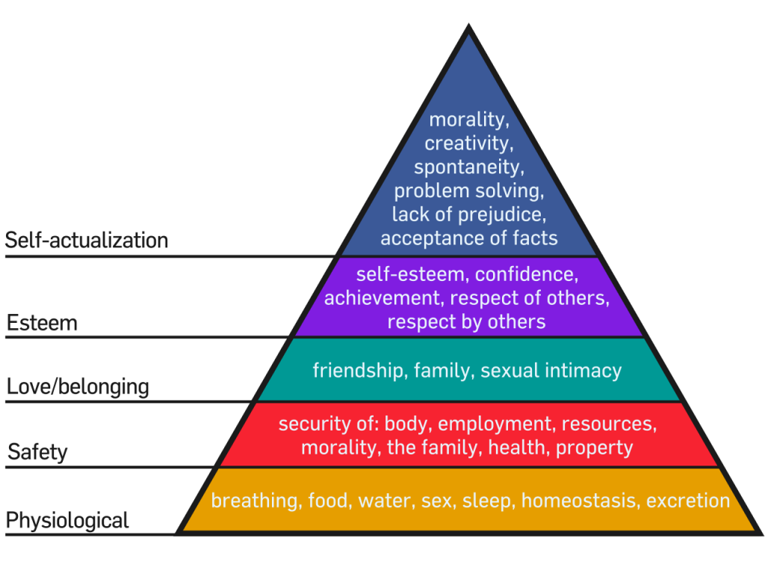
Maslow hierarchy of needs:

Slide 31
CARL ROGERS – person centered theory
He gave person centered theory which states that every person is unique.
One important source of personality differences between people, according to Rogers’s theory, stems from the conditions of worth (or the unconditional positive regard) they experienced in life, especially from their parents when they were young.

Slide 32
MAIN COMPONENTS FOR A PERSONALITY TO GROW
For a person to "grow", they need an environment that provides them with:
Genuineness: (being honest, openness and self-disclosure),
Acceptance / unconditional positive regard: (acknowledging feelings, even problems, without passing judgment)
Empathy: (being listened to and understood).

Slide 33
COMPONENTS OF SELF CONCEPT
Self concept: The self-concept is a general term used to refer to how someone thinks about, evaluates or perceives themselves.
One's self-concept is a collection of beliefs about oneself.
It is comprised of real self and ideal self

Slide 34
ACTIVITY (Real self - Ideal Self)

Slide 35
REAL SELF
It is our self image
It is true self
Have you ever wondered who you really are, deep down inside?
IDEAL SELF
What our parents have taught us
What we admire in others
What our society promotes
What we think is in our best interests

Slide 36
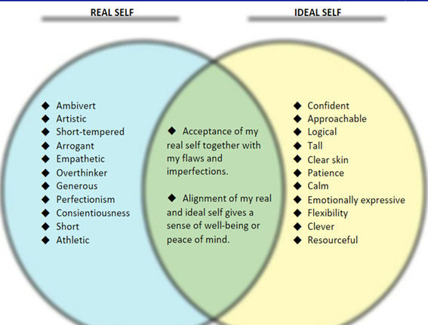
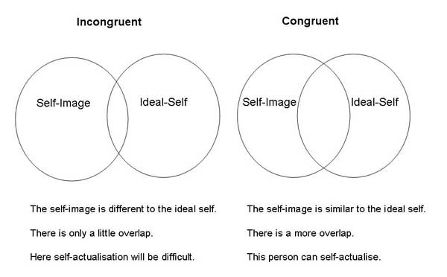

Slide 37
TRAIT THEORIES OF PERSONALITY
Personality Trait: A stable, enduring quality that a person shows in most situations.
Traits are psychological dimensions such as extroversion, tidiness, emotional stability, and curiosity.
Traits have proven extremely useful for describing personality and predicting people’s characteristic patterns of thinking, feeling, and behaving. They are a way to conceptualize and measure how people differ from one another.
This approach is most often adopted by personality researchers, rests on the assumption that people differ from each other on continuous traits; there are not distinct groups, for example “extraverts” and “introverts,” but instead there is a continuum.

Slide 38

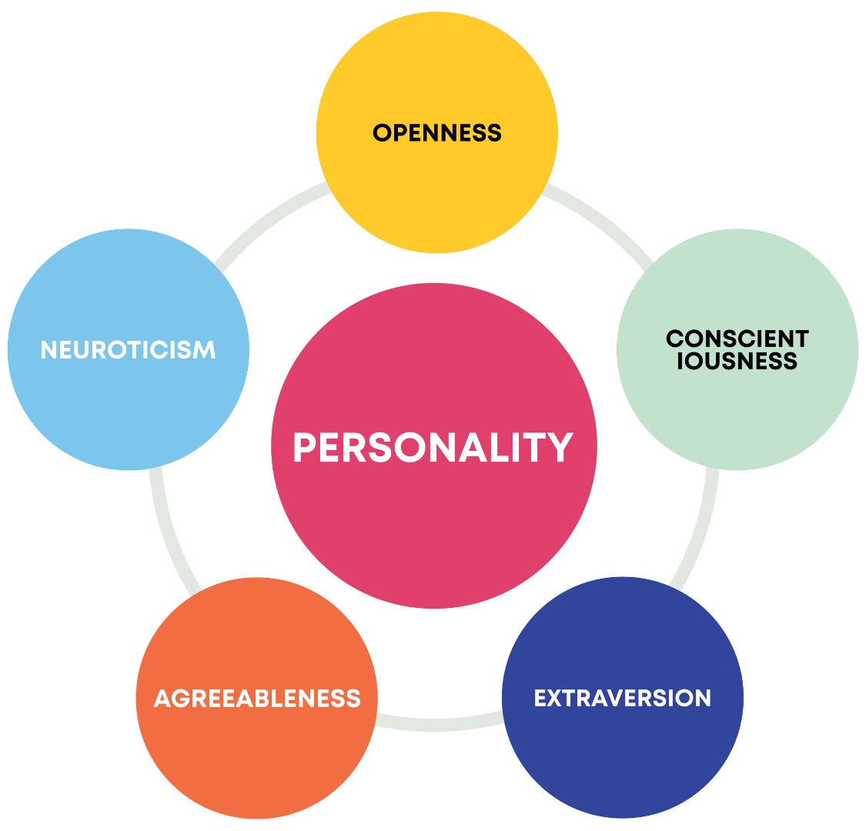

Slide 39
Five-factor model of personality
1. Extraversion
This trait includes characteristics such as excitability, sociability, talkativeness, assertiveness, and high amounts of emotional expressiveness.
2. Agreeableness
This personality dimension includes attributes such as trust, altruism, kindness, willingness to conform to group norms, affection, and other prosocial behaviors.

Slide 40
3. Conscientiousness (Kon.shee.en.shuhs)
Common features of this dimension include high levels of thoughtfulness, with good impulse control and goal-directed behaviors. Those high in conscientiousness tend to be organized and mindful of details.
4. Neuroticism
Individuals high in this trait tend to experience emotional instability, anxiety, moodiness, irritability, and sadness.
5. Openness
This trait features characteristics such as imagination and insight, and those high in this trait also tend to have a broad range of interests.

Slide 41
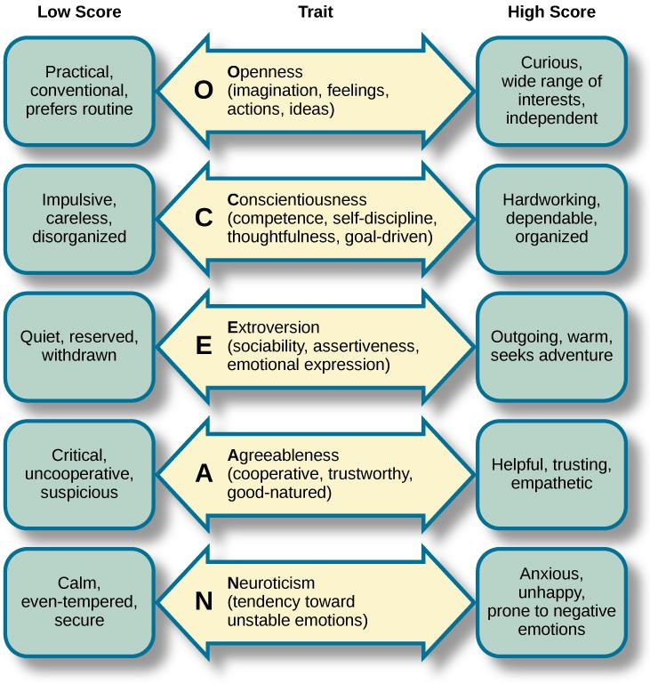

Slide 42
PERSONALITY HAS CONSEQUENCES
The power of personality at work
Personality has been shown to predict how well people do in school and at work.
a. In school, the trait that most strongly predicts getting better grades is conscientiousness (Noftle & Robins, 2007).
b. At work, job performance and success are related to different personality traits depending on the job. One longitudinal study found that personality measured in adolescence predicted who was employed and how high the status of their job was 46 years later (Judge et al., 1999). The people who were most successful at work as adults, as adolescents had been assessed as more extroverted, less neurotic, less agreeable (somewhat surprisingly), and more conscientious than others.

Slide 43
Roberts and his coauthors (2007) identified five possible explanations of how personality predicts who does well in school and at work:
a. Personality may affect how attracted a person is to a particular course of study or career. People may choose college majors or careers suited to their personality.
b. Personality may affect who is recruited into a particular career. Other people (e.g., employers, teachers, advisors) may encourage a person to pursue a field that suits his or her personality.
c. Personality may affect the impact a person has on his or her work environment. People whose personalities are well suited to their role at work or at school may perform better and create a better work environment for themselves (and others).
d. Personality may predict who drops out of school, a job, or career.
e. Personality may have a direct effect on performance. Some personality traits may give people advantages for some jobs or educational settings.

Slide 44
Personality in relationships
Personality has been shown to predict who is likely to have more satisfying romantic relationships and more likely to get divorced.
The personality traits most strongly associated with divorce are high neuroticism, low agreeableness, and low conscientiousness. The main reason personality can predict who gets divorced is, people with more pleasant personalities (low neuroticism, high agreeableness, and high conscientiousness) have more pleasant relationships.

Slide 45
ASSIGNMENT
Five-factor model of personality
The Big Five Personality test, also known as the Five Factor Model, is a personality test based on the assumption that personality can be sufficiently described by five personality traits

